Slide 1
Networking Media

Slide 2
Terms You Should Know
Conducted (Guided) Media –
provides a physical path (wire or cable);
signal moves from end to end;
most common today
Radiated (Unguided) Media –
transmission of waves through the air (Wireless), water or a vacuum.
Growing its popularity day by day.

Slide 3
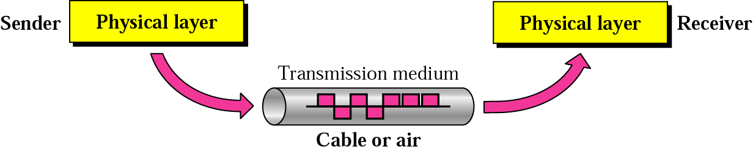
Physical Media
Physical Media

Slide 4
Transmission Medium
Physical Media
Copper
Coaxial Cable - Thick or Thin
Unshielded Twisted Pair (UTP) - CAT 3,4,5,5e&6
Shielded Twisted Pair (STP)
Optical Fiber
Multi mode
Single mode
Wireless
Short Range
Medium Range (Line of Sight)
Satellite

Slide 5
General Cable Characteristics
The following characteristics apply network cabling:
Bandwidth rating
Frequency rating
Maximum segment length
Maximum number of segments per internetwork
Maximum number of devices per segment
Interference susceptibility
Connection hardware
Cable grade
Bend radius
Material costs
Installation costs

Slide 6
Unshielded Twisted Pair (UTP)
The most common copper medium
During transmission, wires generate an electromagnetic field which interferes with other wires in parallel (Crosstalk)
Twisting the pair reduces crosstalk (called cancellation) and hence the name “Twisted pair.”

Slide 7
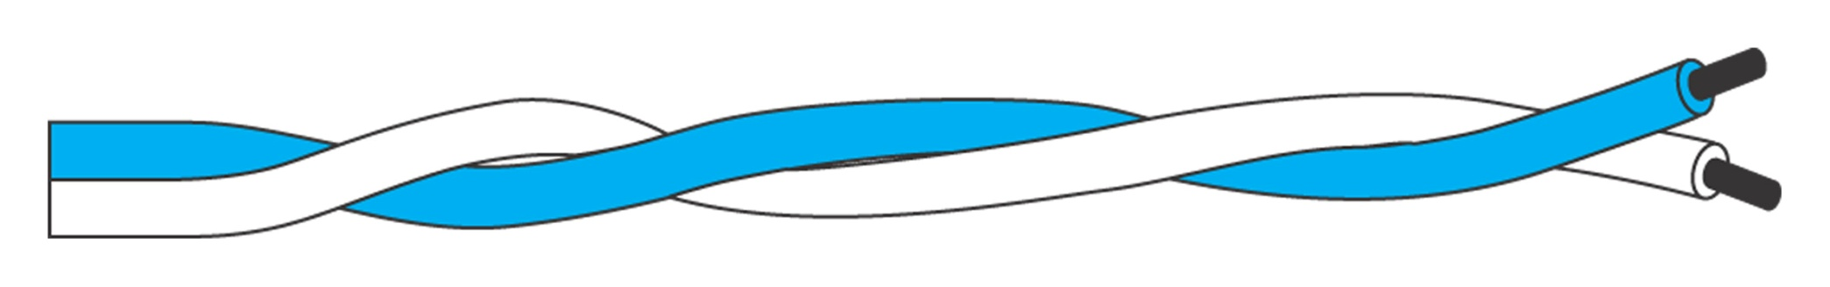
Figure : Twisted pair wires are the most commonly used medium for communications transmission.

Slide 8
UTP Cabling Categories
UTP cabling is rated according to a number of categories devised by the TIA and EIA; since 1991, ANSI has also endorsed these standards
ANSI/TIA/EIA 568 Commercial Building Wiring Standard for commercial environments includes:
Category 1 (voicegrade)
Category 2: up to 4 Mbps
Category 3: up to 10 Mbps (16 MHz)
Category 4 (datagrade): up to 16 Mbps (20 MHz)
Category 5: up to 100 Mbps (100 MHz)
Category 5e: up to 1000 Mbps (100 MHz)
Category 6: up to 10000 Mbps (200 MHz)

Slide 9
EIA UTP Categories
Cat 1: telephone (voice); not for data
Cat 2: 4 twisted pairs; up to 4Mbps
Cat 3: 4 twisted pairs, minimum 3 twists per foot; up to 10Mbps
Cat 4: 4 twisted pairs; more twists per foot than Cat 3; up to 20Mbps

Slide 10
EIA UTP Categories
Cat 5: 4 twisted pairs; up to 4 twists per inch; pairs are also twisted; up to 100Mbps
Cat 5e: highest quality Cat 5; up to 1000Mbps (Gigabit)
Cat 6: 4 twisted pairs; each pair surrounded with aluminum foil; highest performing UTP; longer distance
Cat 7: under development; each pair is shielded; thicker jacket; fiber used instead

Slide 11
EIA Cable Connectors
RJ 11: 6 wire conductor; phone wire mainly; not for data
RJ 45: 8 wire conductor; used for data in LANs; 2 pair used for most 10BASET LANs; all 4 pair used for 100Mbps (full duplex)

Slide 12
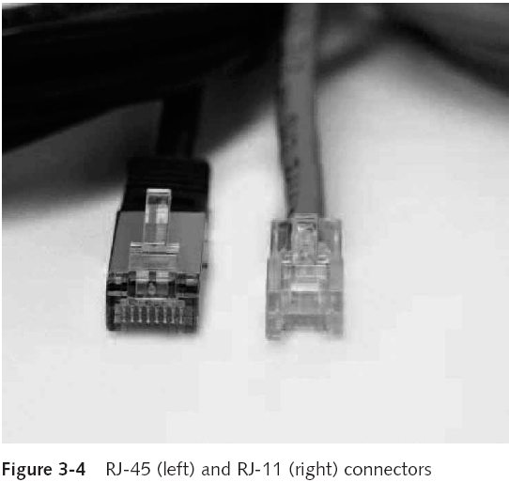
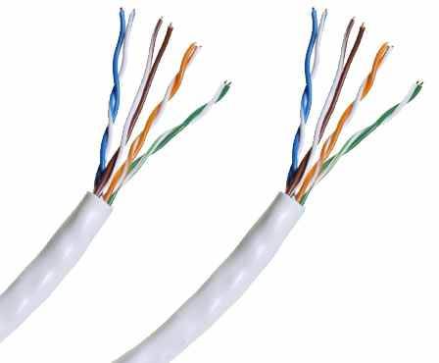
Twisted-Pair Cable (continued)

Slide 13
Baseband and Broadband Transmission
Baseband transmission uses a digital encoding scheme at a single fixed frequency, where signals take the form of discrete pulses of electricity or light
Repeaters can be used to deal with “attenuation”
Broadband transmission systems use analog techniques to encode binary 1s and 0s across a continuous range of values
Multiple analog transmission channels can operate on a single broadband cable
Amplifiers can be used to deal with attenuation

Slide 14
Baseband Vs Broadband Transmission
In a baseband transmission, the entire bandwidth of the cable is consumed by a single signal. In broadband transmission, signals are sent on multiple frequencies, allowing multiple signals to be sent simultaneously.
Baseband refers to a message signal that is transmitted and broadband refers to send the message to every one who is having a receiver.
Baseband can carry both analog and digital signal where as broadband carries analog signal.
Baseband is like point to point communication and broadband to is point to multi-point communication.
Baseband will carry single signal in a medium but broadband can carry multisignals through single medium with shared bandwidth

Slide 15
UTP – Pros and Cons
Advantages –
Easy to install
Less expensive than most copper media
Takes up less room
Disadvantages –
Prone to EMI and RFI
Limited distance (typically 100 meters)
Requires Repeaters for segments that exceed 100 meters

Slide 16
Shielded Twisted Pair
Twisted pairs are encased in metallic shielding which in turn are encased in another metallic shield or braid and then wrapped in plastic
Less susceptible to EMI and RFI and handles higher speeds
More expensive and harder to install (requires a ground wire)
Used mainly for IBM Token Ring

Slide 17
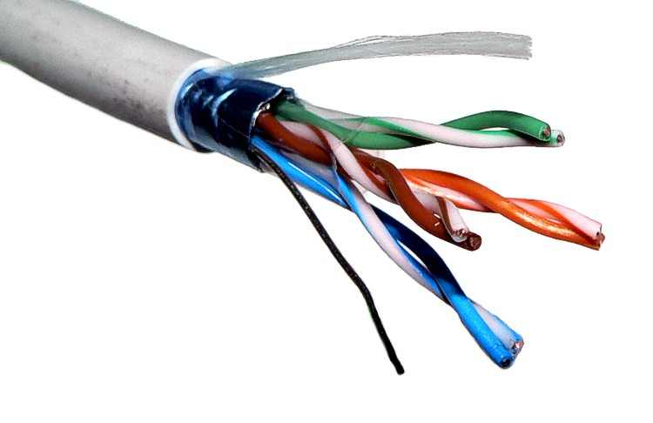
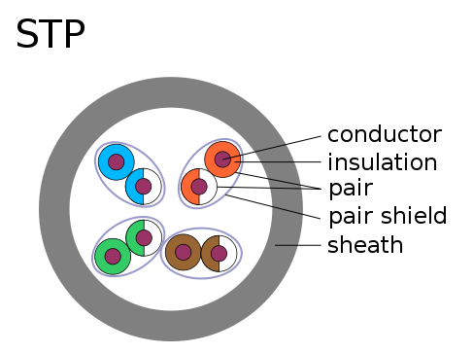

Slide 18
Coaxial Cable - Coax
Central Conductor - usually copper
Insulation Layer - plastic or air
Shield, braided aluminum (second conductor)
Outer Insulation - plastic or PVC
Connector – BNC (Bayonet Neill–Concelman); twist and lock

Slide 19
Coaxial Cable - Coax
Advantages –
Higher Bandwidth
Greater Distances
Easy to tap
Immune from EMI
Disadvantages –
Bulky
Hard to install (large bend radius)
Security (easy to tap)

Slide 20
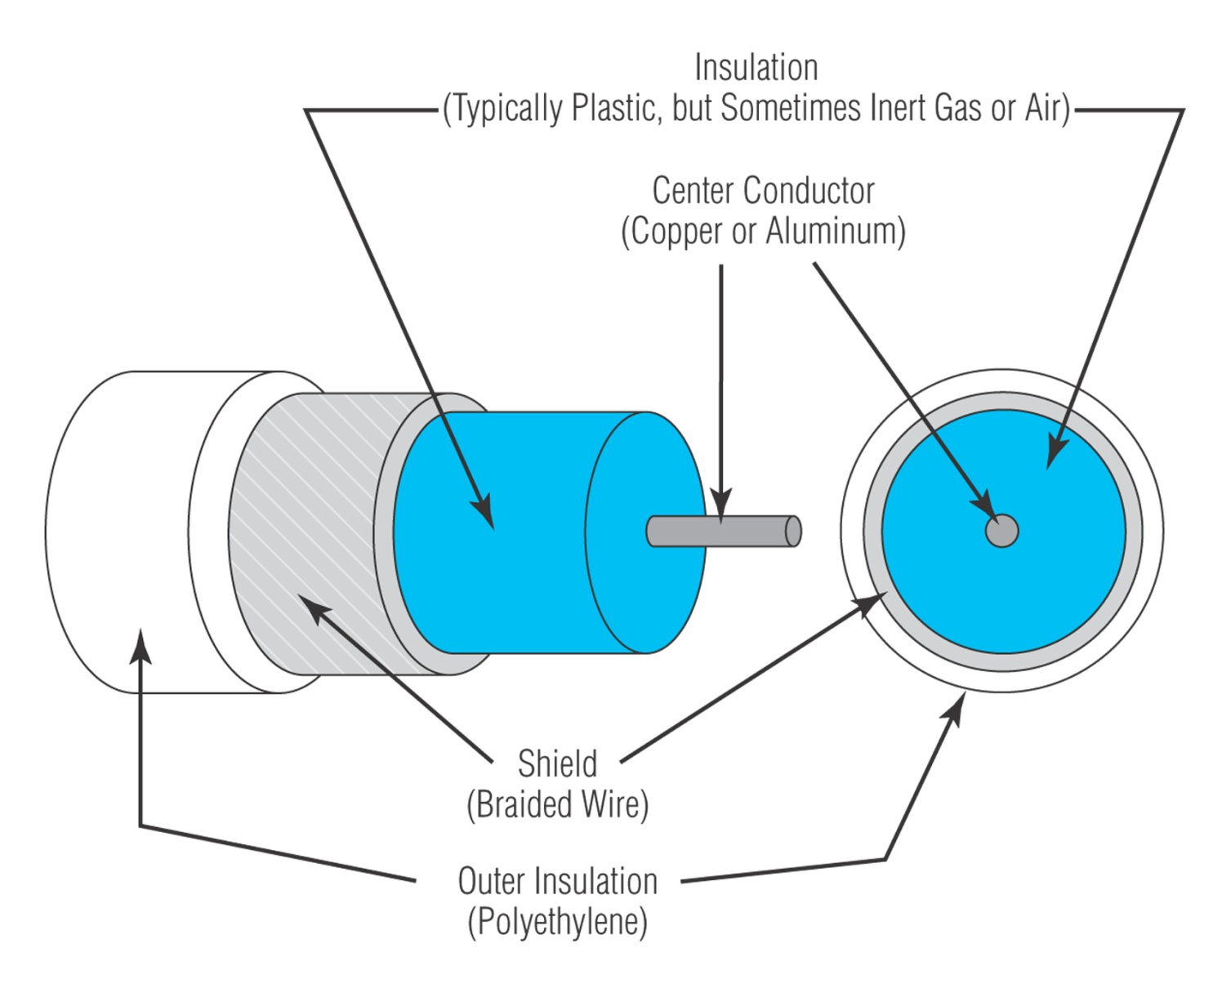
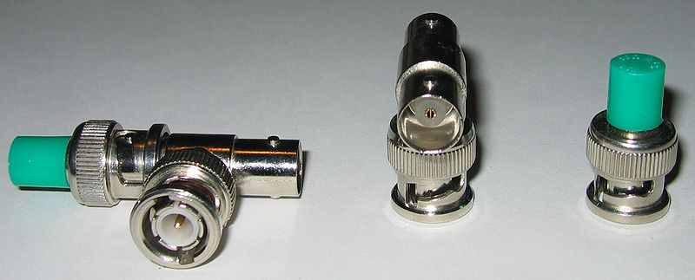

Slide 21
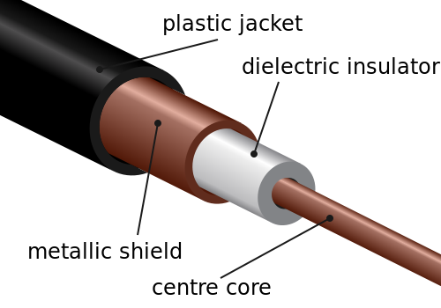
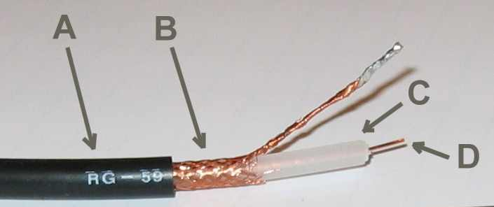

Slide 22

Fiber Media
Physical Media
Optical fibers use light to send information through the optical medium.
It uses the principal of total internal reflection.
Modulated light transmissions are used to transmit the signal.

Slide 23
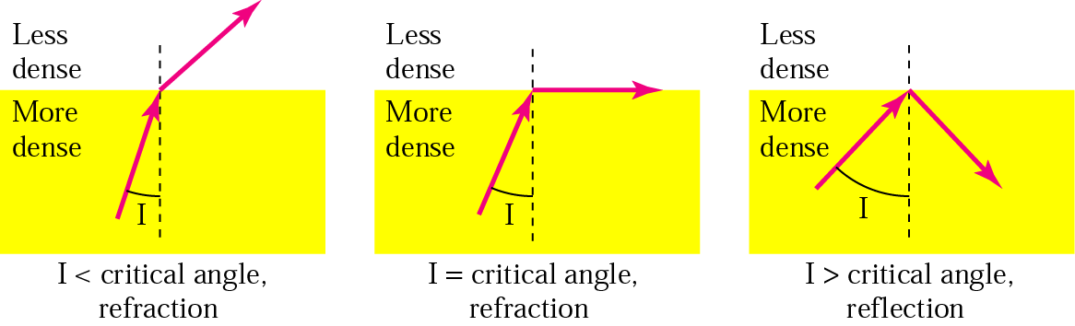
Total Internal Reflection
Physical Media

Slide 24
Fiber Media
Physical Media
Light travels through the optical media by the way of total internal reflection.
Modulation scheme used is intensity modulation.
Two types of Fiber media :
Multimode
Singlemode
Multimode Fiber can support less bandwidth than Singlemode Fiber.
Singlemode Fiber has a very small core and carry only one beam of light. It can support Gbps data rates over > 100 Km without using repeaters.

Slide 25
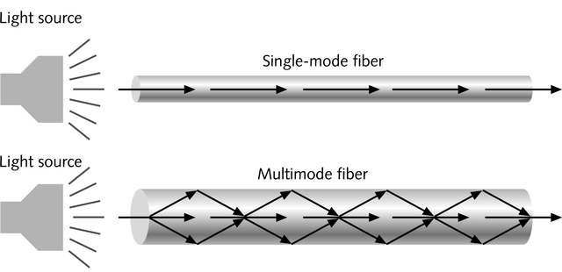
Single and Multimode Fiber
Physical Media
Single-mode fiber
Carries light pulses along single path
Uses Laser Light Source
Multimode fiber
Many pulses of light generated by LED travel at different angles

Slide 26
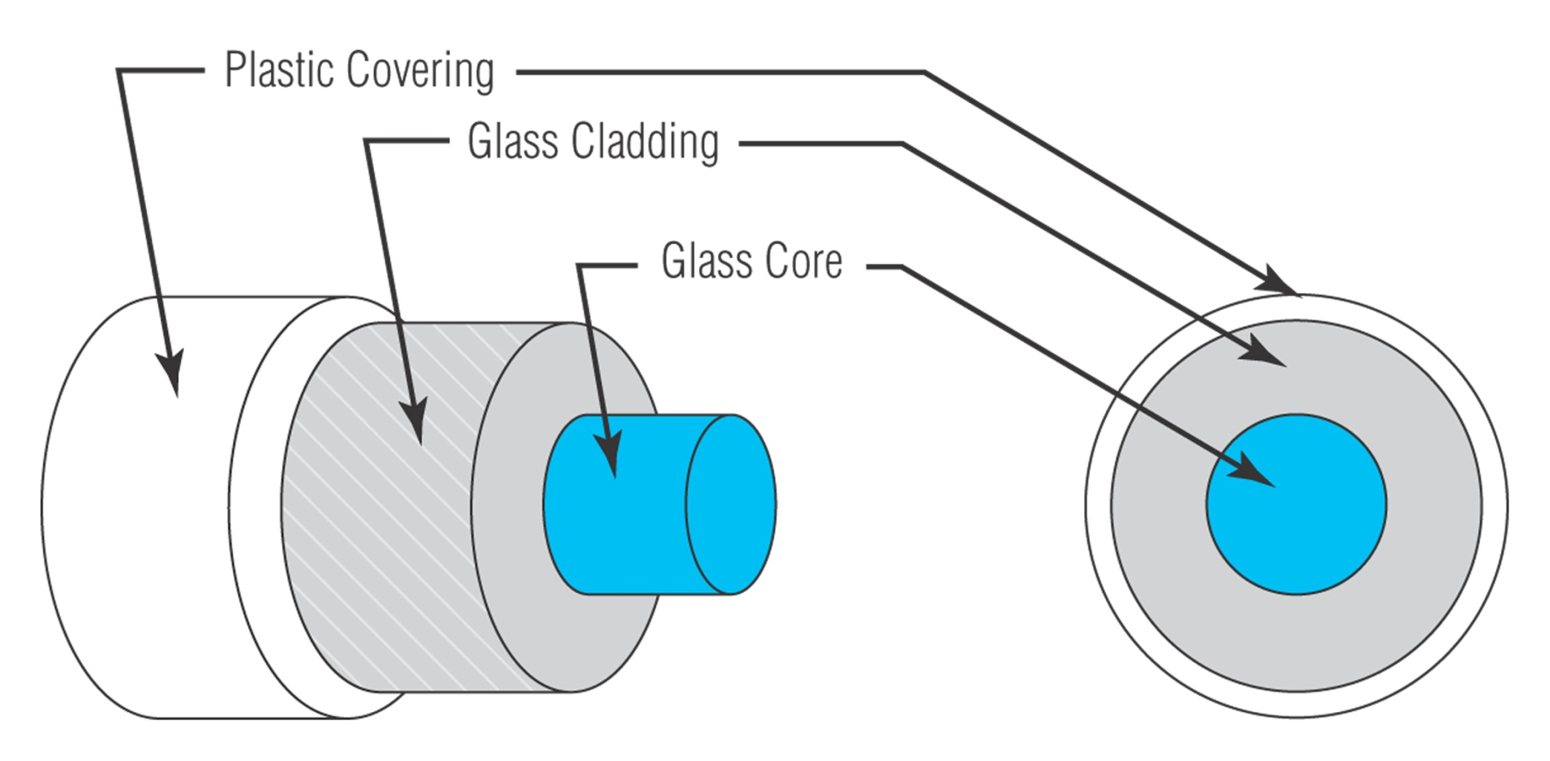
Parts of optical fiber cable.

Slide 27
Optical Fiber
Glass Core; radius from 9 to 62.5 microns
Glass or plastic cladding (up to 125 microns)
Plastic Covering
Optional Kevlar ( or other) strands for support

Slide 28
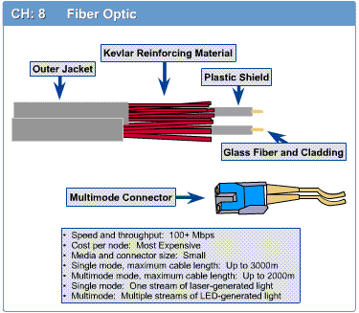
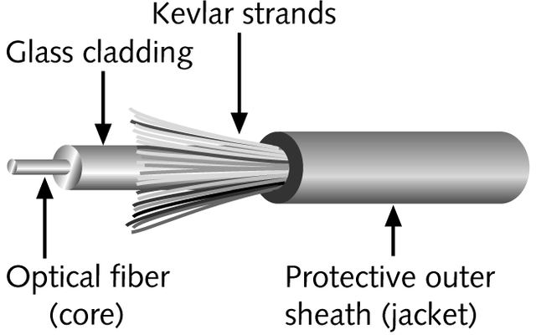
Fiber-Optic Cable
Physical Media
Contains one or several glass fibers at its core
Surrounding the fibers is a layer called cladding

Slide 29
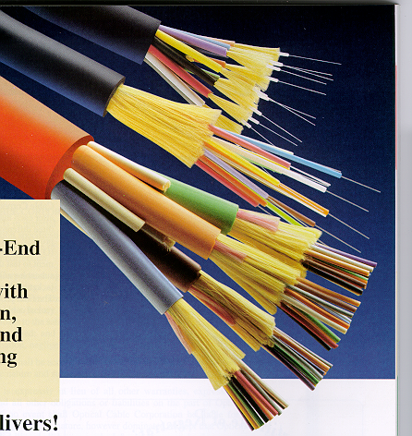
Fiber Optic Cable
Physical Media
FO Cable may have 1 to over 1000 fibers

Slide 30
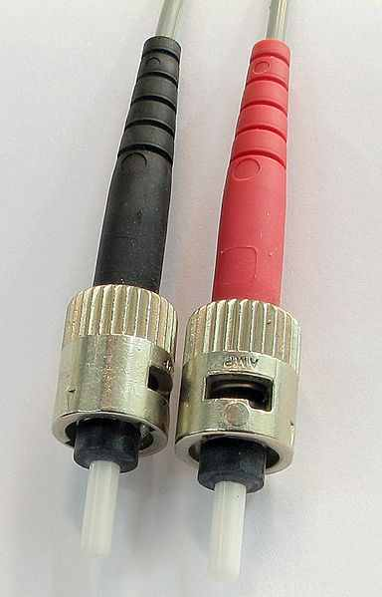
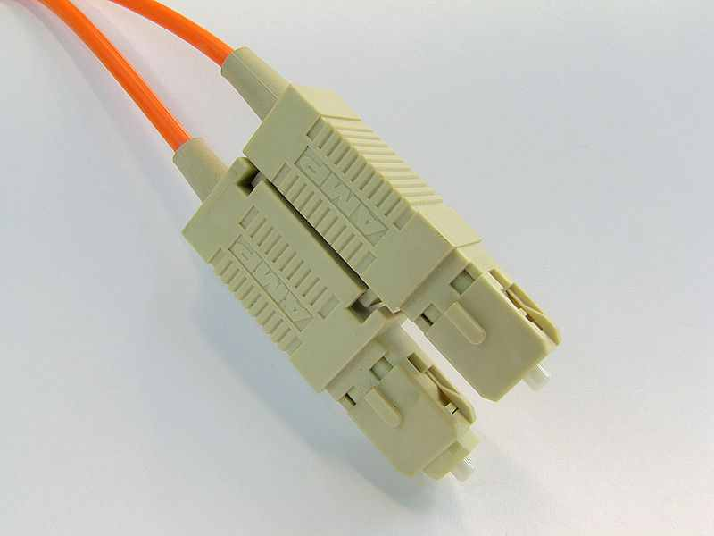
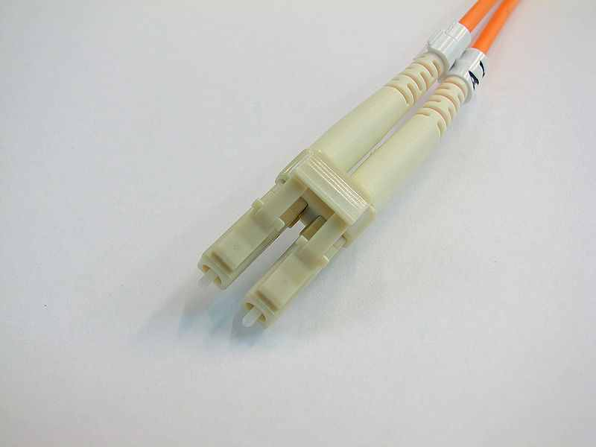
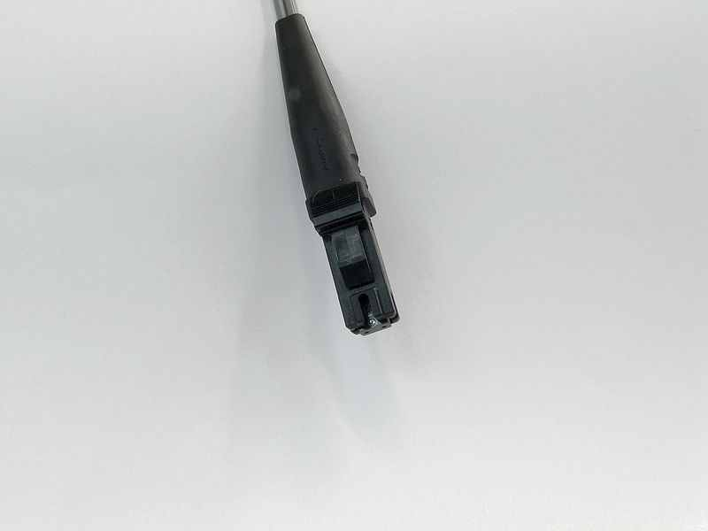
Fiber-Optic Cable (Connectors)
ST-(straight tip)
SC-(Square Connector)
MT-RJ (Mechanical Transfer Registered Jack or Media Termination - recommended jack)
LC-(Lucent Connector, Little Connector, or
Local Connector)

Slide 31
Cable Selection Criteria
Criteria to be considered for a network installation
Bandwidth
Budget
Capacity
Environmental considerations
Placement
Span
Local requirement
Existing cable plant

Slide 32
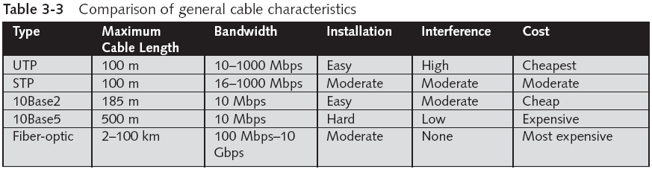
Cable Selection Criteria (continued)

Slide 33
Managing and Installing the Cable Plant
Important to understand basic methods and terminology of cable management
The TIA/EIA developed the document “568 Commercial Building Wiring Standard,” which specifies how network media should be installed to maximize performance and efficiency
Standard defines “structured cabling”

Slide 34
Structured Cabling
Specifies how cabling should be organized
Relies on an extended star physical topology
Can be applied to any size network
Details of a cable plant have six components
Work area
Horizontal wiring
Telecommunications closets
Equipment rooms
Backbone or vertical wiring
Entrance facilities

Slide 35
Work Area
The work area is where computer workstations and other user devices are located
Faceplates and wall jacks are installed in the work area, and patch cables connect computers and printers to wall jacks, which are in turn connected to a nearby telecommunications closet
Patch cables should be less than 6 meters long
TIA/EIA 568 standard calls for at least one voice and one data outlet on each faceplate in each work area
Connection between wall jack and telecommunica-tions closet is made with horizontal wiring

Slide 36
Horizontal Wiring
Horizontal wiring runs from the work area’s wall jack to the telecommunications closet and is usually terminated at a patch panel
Acceptable horizontal wiring types include four-pair UTP (Category 5e or 6) or two fiber-optic cables
Horizontal wiring from the wall jack to the patch panel should be no longer than 90 meters
Patch cables in the work area and in the telecommunications closet can total up to 10 meters

Slide 37
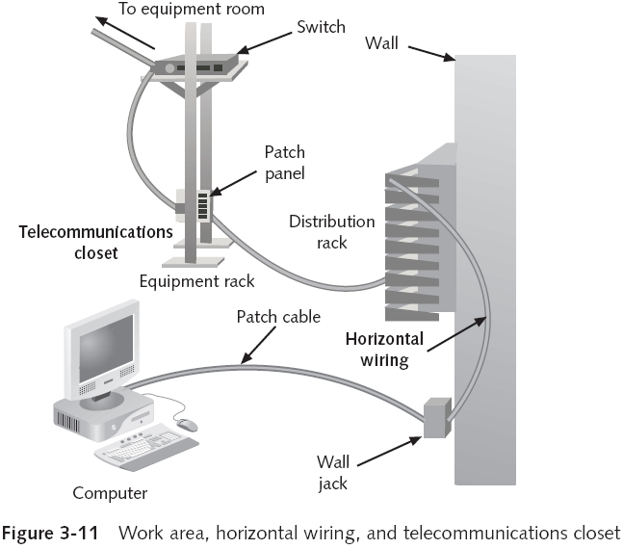
Telecommunications Closet

Slide 38
Equipment Rooms
The equipment room houses servers, routers, switches, and other major network equipment, and serves as a connection point for backbone cabling running between TCs
Can be the main cross-connect of backbone cabling for the network, or it might serve as the connecting point for backbone cabling between buildings
In multibuilding installations, each building often has its own equipment room

Slide 39
Backbone Cabling
Backbone cabling (or vertical cabling) interconnects TCs and equipment rooms
Runs between floors or wings of a building and between buildings
Frequently fiber-optic cable but can also be UTP
When it connects buildings, it is usually fiber-optic
Multimode fiber can extend up to 2000 meters
Single-mode fiber can reach distances up to 3000
Between equipment rooms and TCs, the distance is limited to 500 meters for both fiber-optic cable types
From the main cross-connect to equipment rooms, fiber-optic cable can run up to 1500 meters

Slide 40
Entrance Facilities
An entrance facility is the location of the cabling and equipment that connects a corporate network to a third-party telecommunications provider
Can serve as an equipment room and the main cross-connect for all backbone cabling
It is also where a connection to a WAN is made and the point where corporate LAN equipment ends and a third-party provider’s equipment and cabling begins—also known as the “demarcation point”

